Slide 1
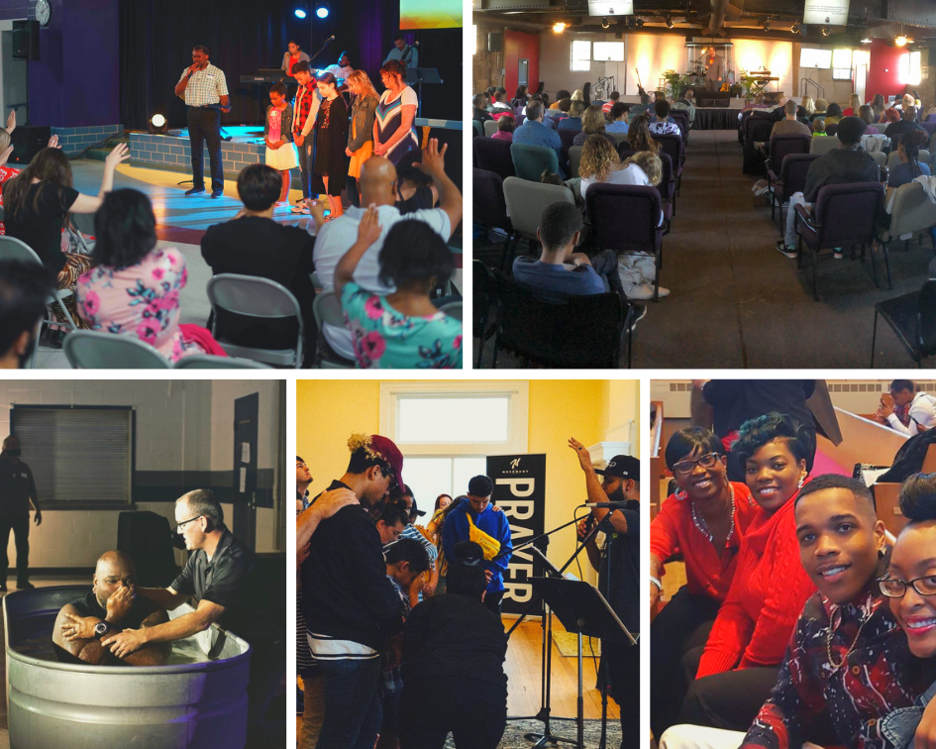
GLC Church Plant Highlights

Slide 2
LIFE CHURCH LIVONIA
Pastor:
Brian Nanninga
Planted: January 1, 2014
Current weekly attendance: 230
LIVONIA, MICHIGAN

Slide 3
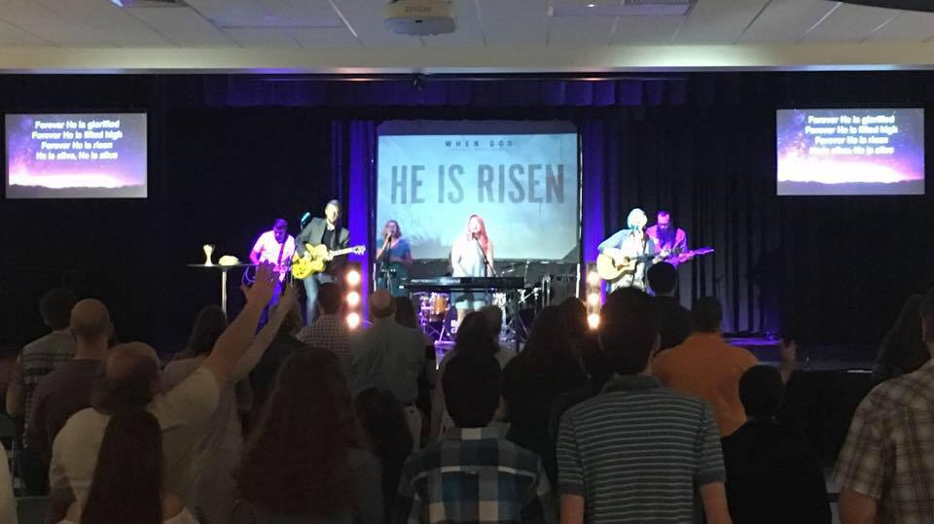
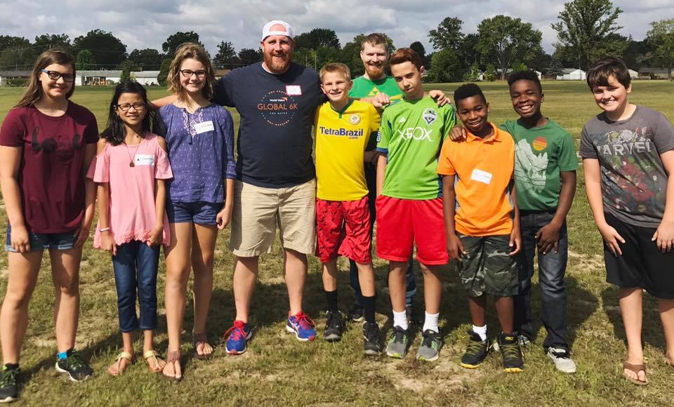
Life Church Livonia

Slide 4
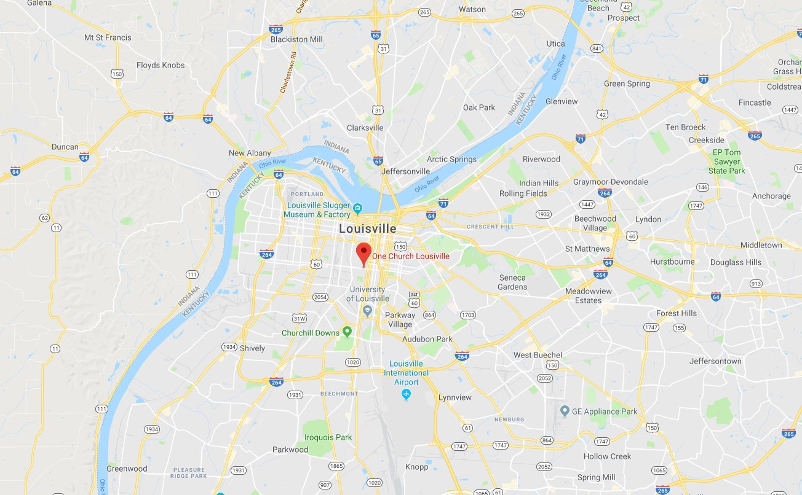
ONE CHURCH
Co-Pastors:
Ja’mel Armstrong
Matt Ness
Planted:
January 31, 2016
Current weekly attendance: 100
LOUISVILLE, KENTUCKY

Slide 5
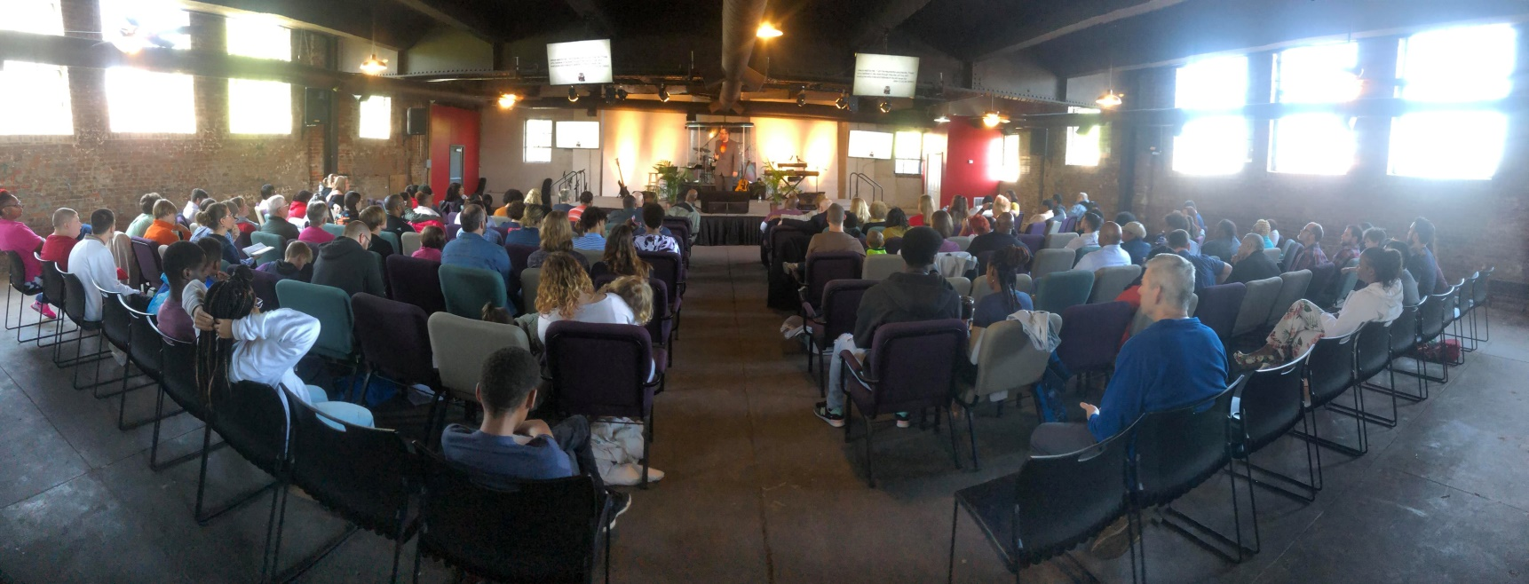
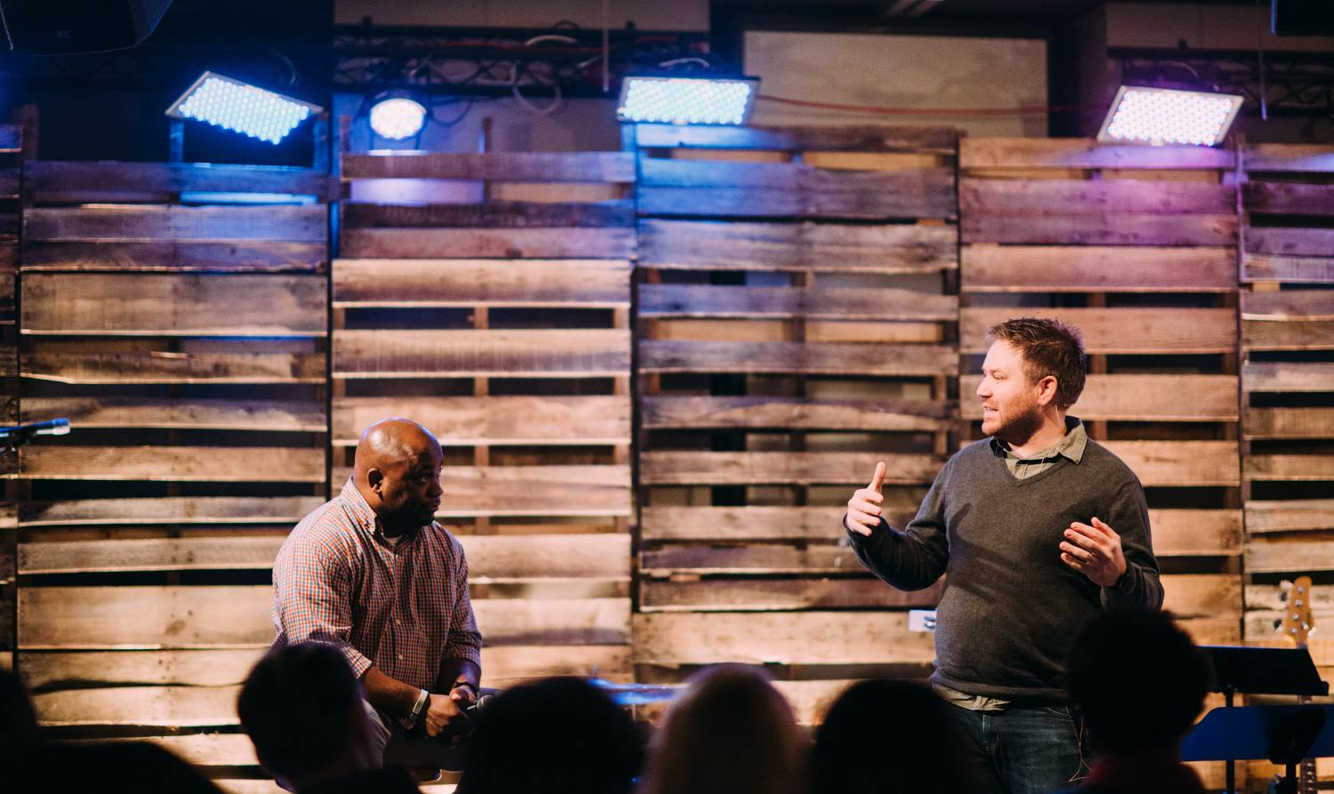
One Church - Louisville

Slide 6
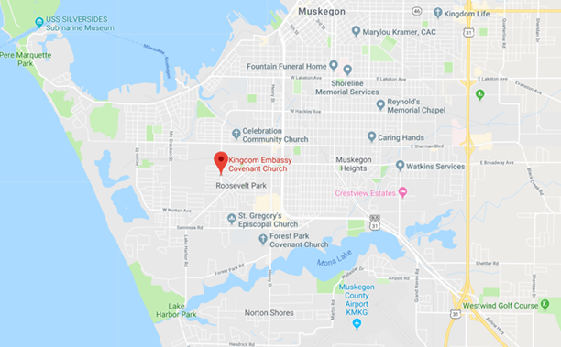
KINGDOM EMBASSY
Pastor:
Arthur Duren
Planted:
December 1, 2016
Current weekly attendance: 230
MUSKEGON, MICHIGAN

Slide 7
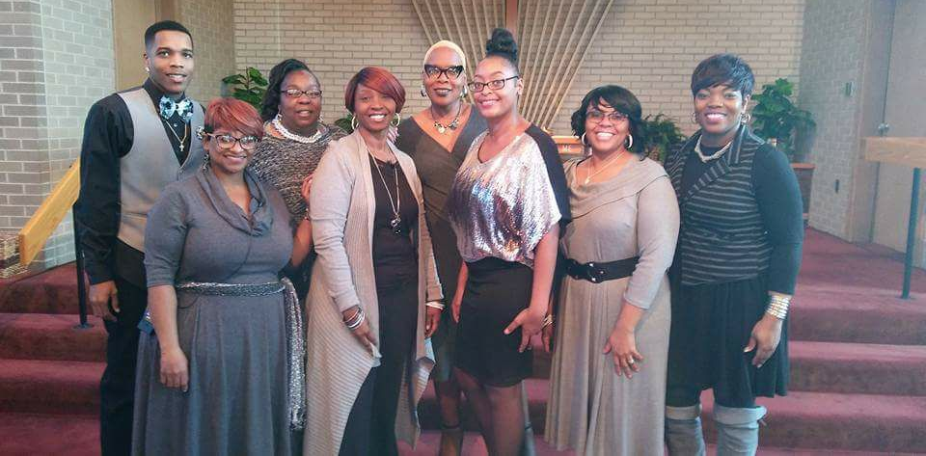
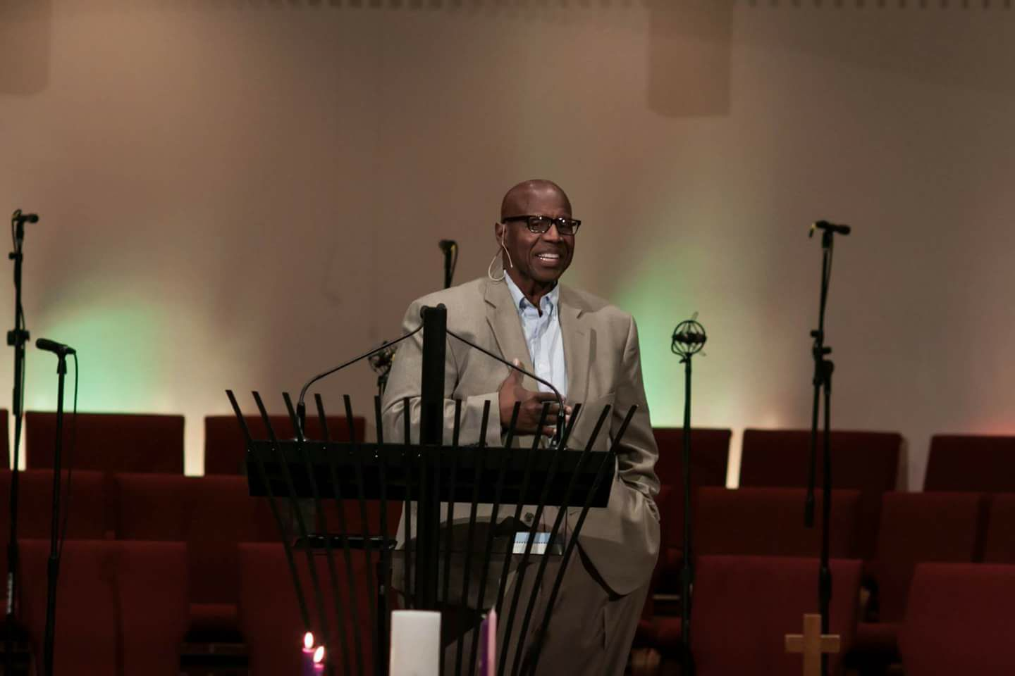
Kingdom Embassy - Muskegon

Slide 8
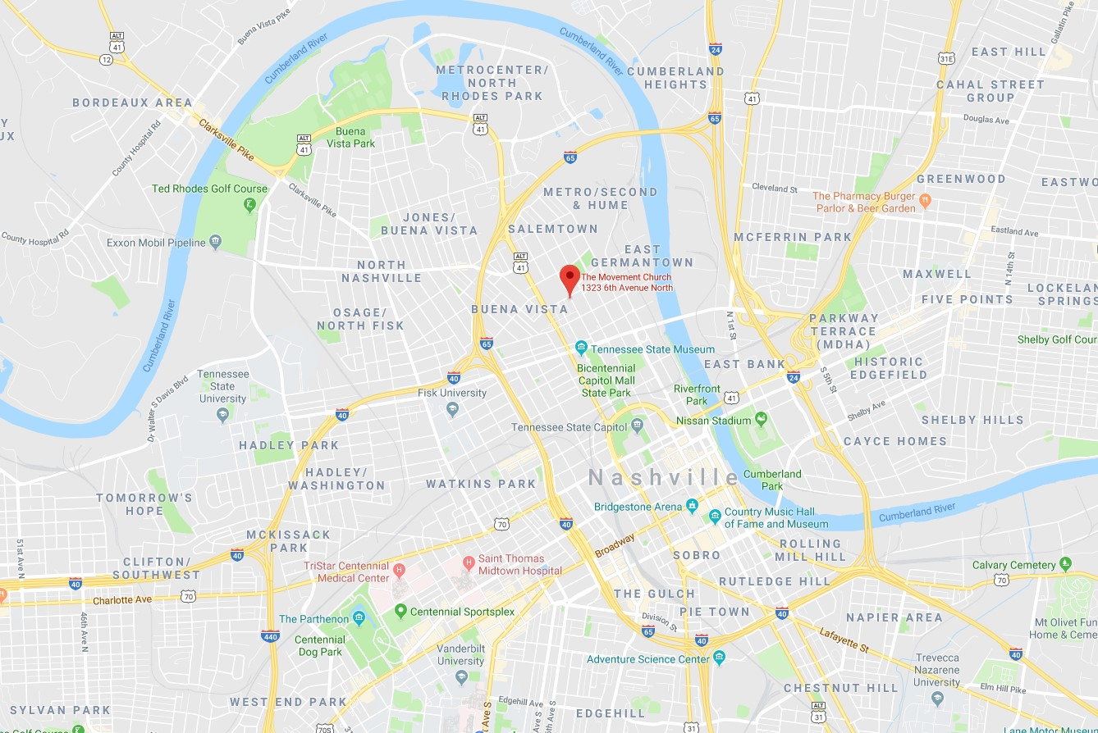
THE MOVEMENT CHURCH
Pastor:
Joey Maldonado
Planted:
October 1, 2017
Current weekly attendance: 70
NASHVILLE, TENNESSEE

Slide 9
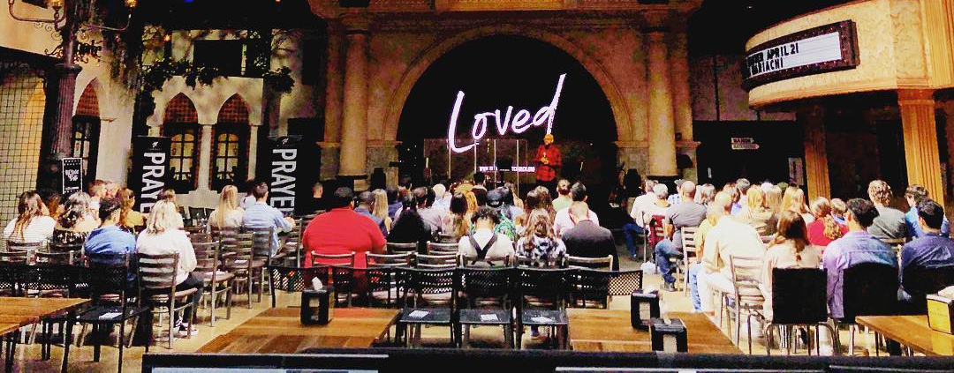
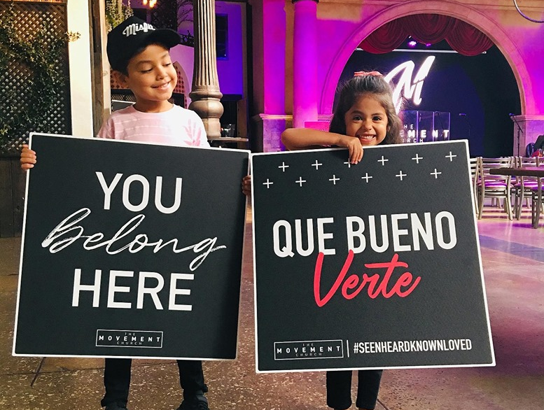
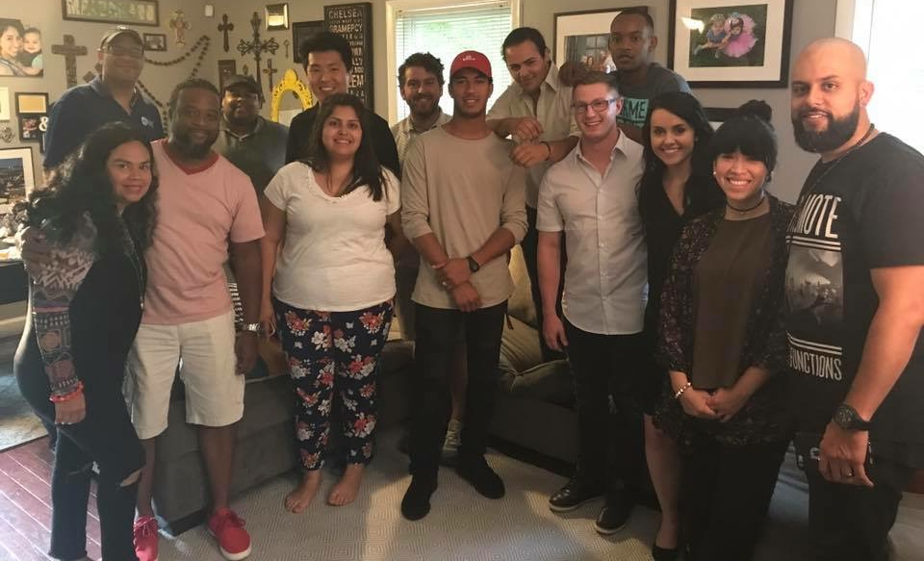
Life Church Auburn Hills

Slide 10
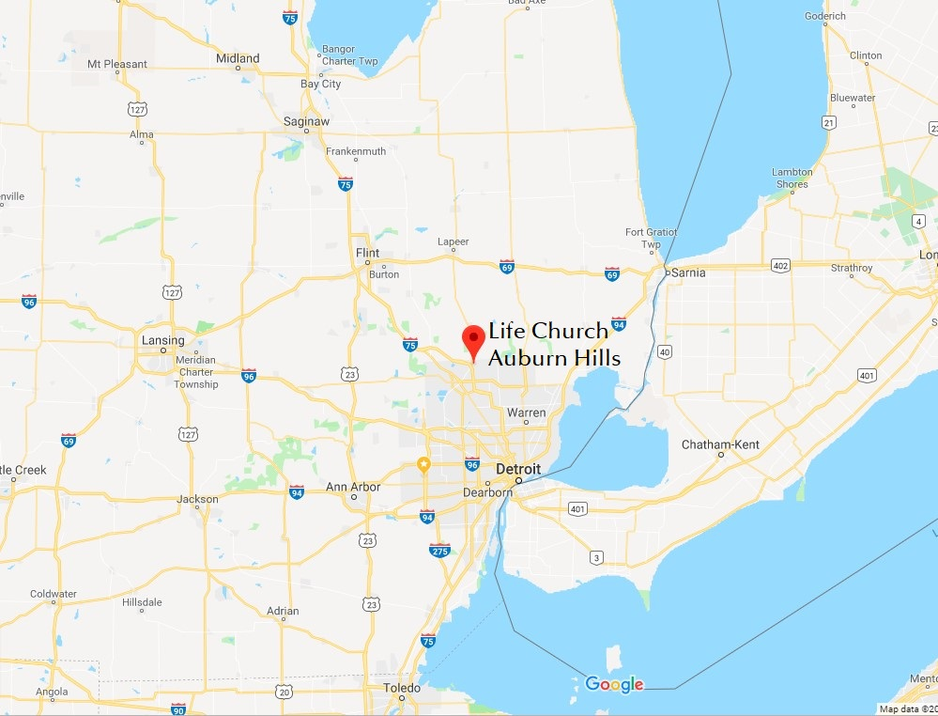
LIFE CHURCH AUBURN HILLS
Pastor:
Donearl Johnson
Planted:
January 15, 2019
Current weekly attendance: 130
AUBURN HILLS, MICHIGAN

Slide 11
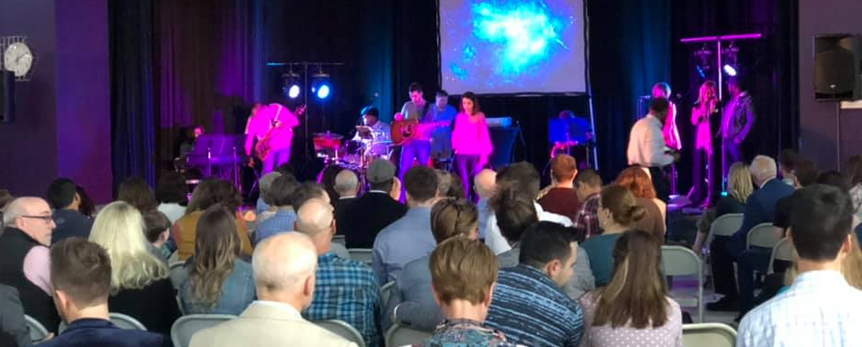
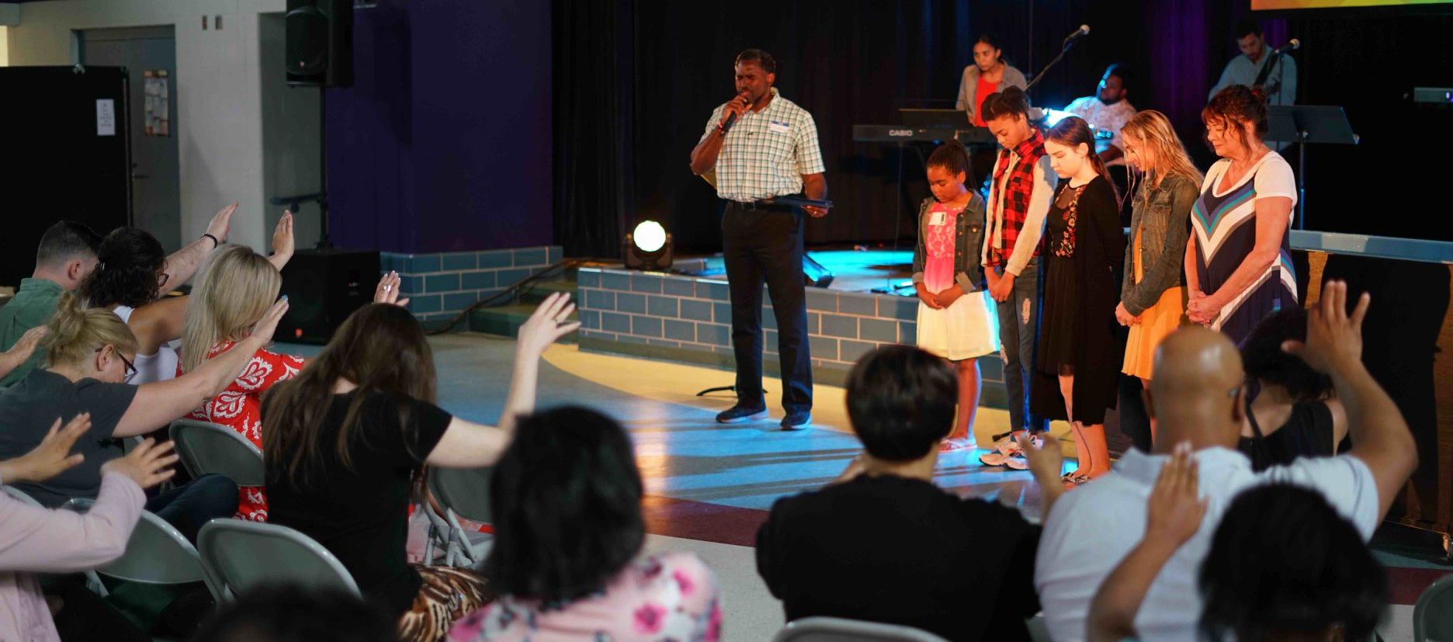
Life Church Auburn Hills

Slide 12
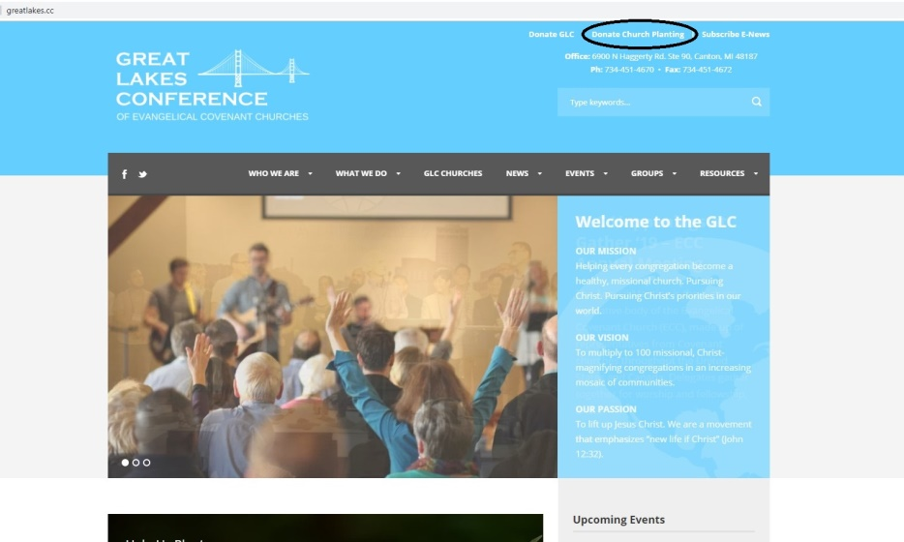
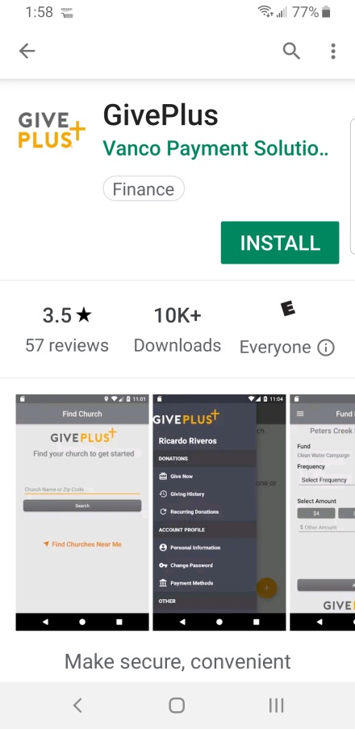
How to Give Online: GLC Website or Vanco Give Plus App
www.greatlakes.cc
Go to the App Store on your phone and enter in “Vanco
Give Plus”
Install and Open

Slide 13
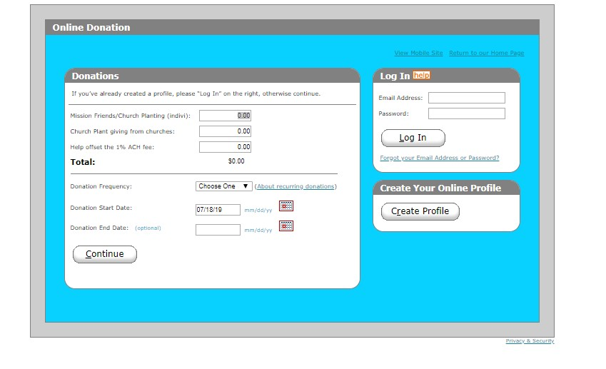
www.greatlakes.cc

Slide 14
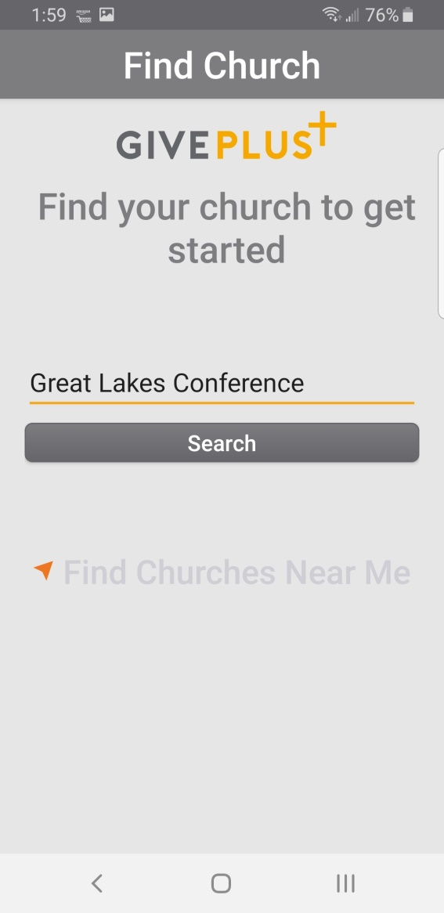
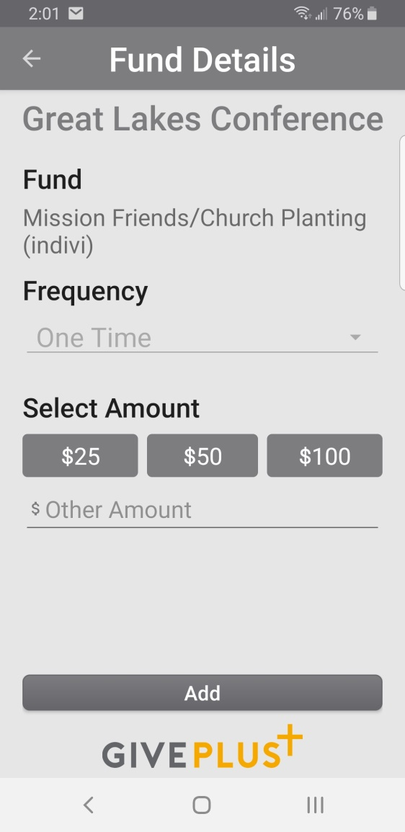
Vanco Give Plus

